Slide 1
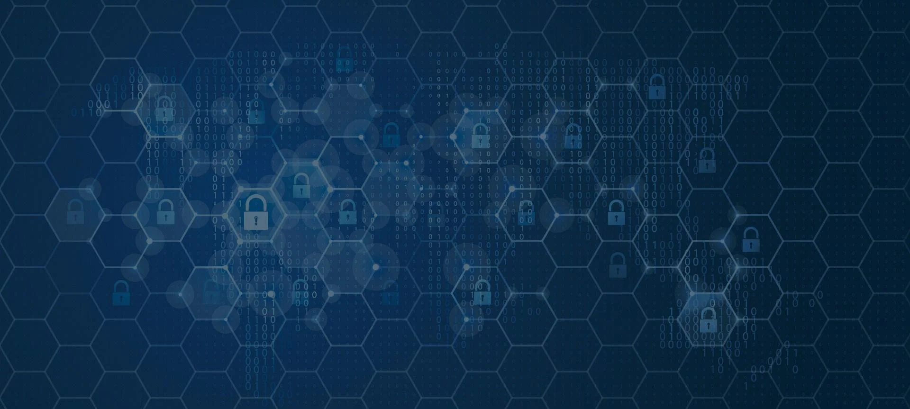
ABOUT- PHISHING ATTACKS
WELCOME
TO THE WORLD OF CYBERSECURITY
GUIDANCE -
CODEALPHA
BY SIDRAH TOLA

Slide 2

INTRODUCTION
In This Day And Age, Cybersecurity Is At The Forefront Of Operational Priorities. High-profile Data Breaches Have Taught The Hard-earned Lesson That Protecting Data And Personally Identifiable Information (PII) Needs To Take Precedence. Among One Of The Most Prevalent Threats To Organizations Is Phishing.
PHISHING

Slide 3
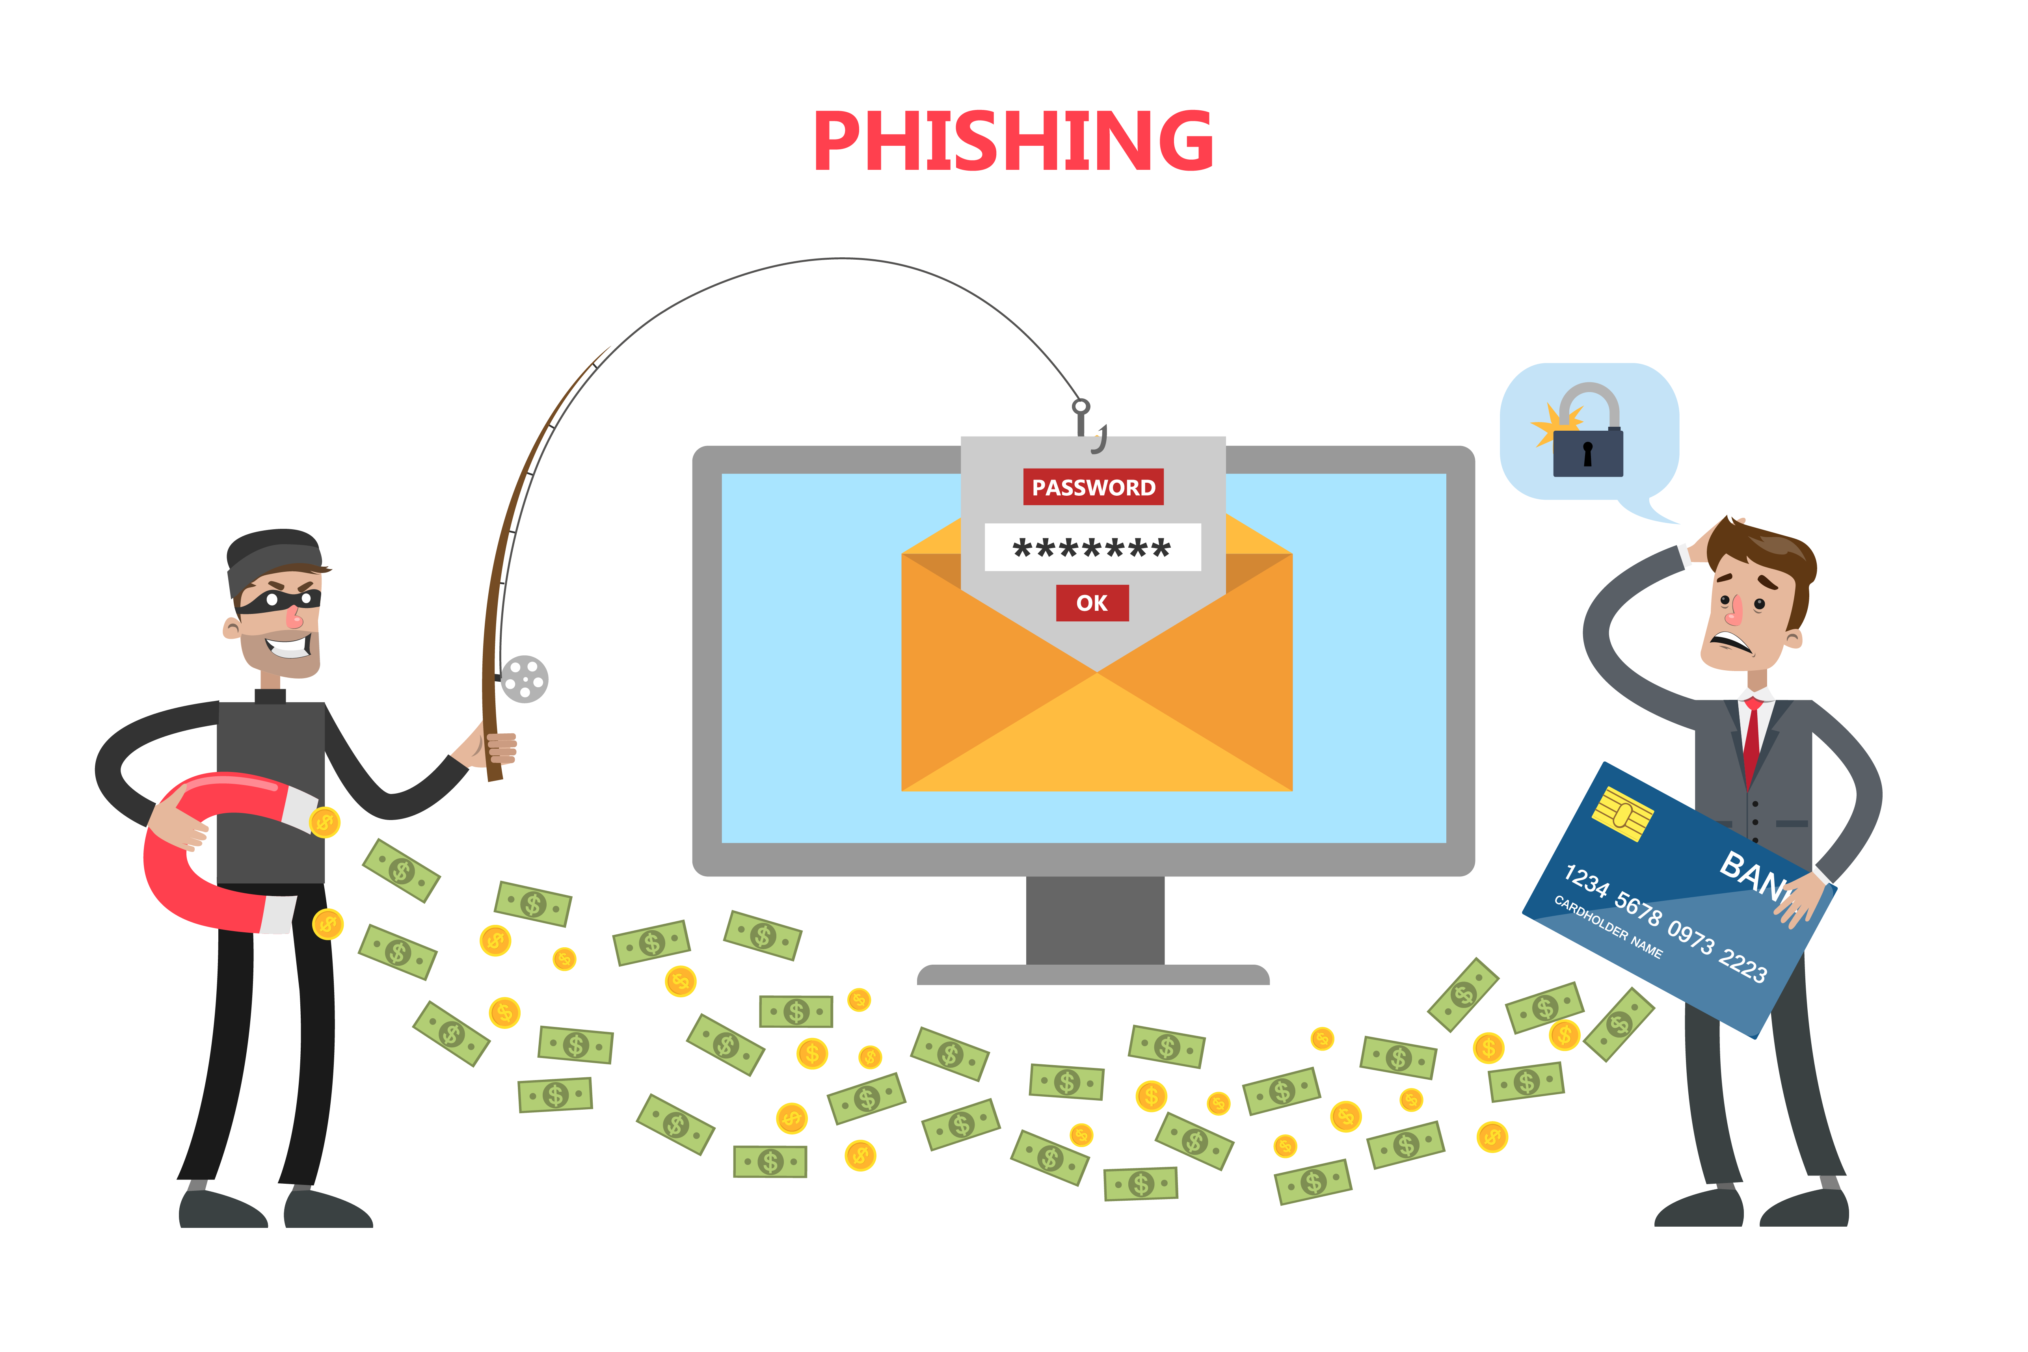
What is phishing ?
Phishing is a type of cyberattack that uses email (traditional phishing), phone (vishing or voice phishing) or text (smishing or SMS phishing) to entice individuals into providing personal or sensitive information to cybercriminals. This information can range from passwords, credit card information and social security numbers to details about a person or an organization. Attackers pose as legitimate representatives to gain this information, which is then used to access accounts or systems. Ultimately, once in the hands of adversaries, it often leads to identity theft or significant financial loss.

Slide 4
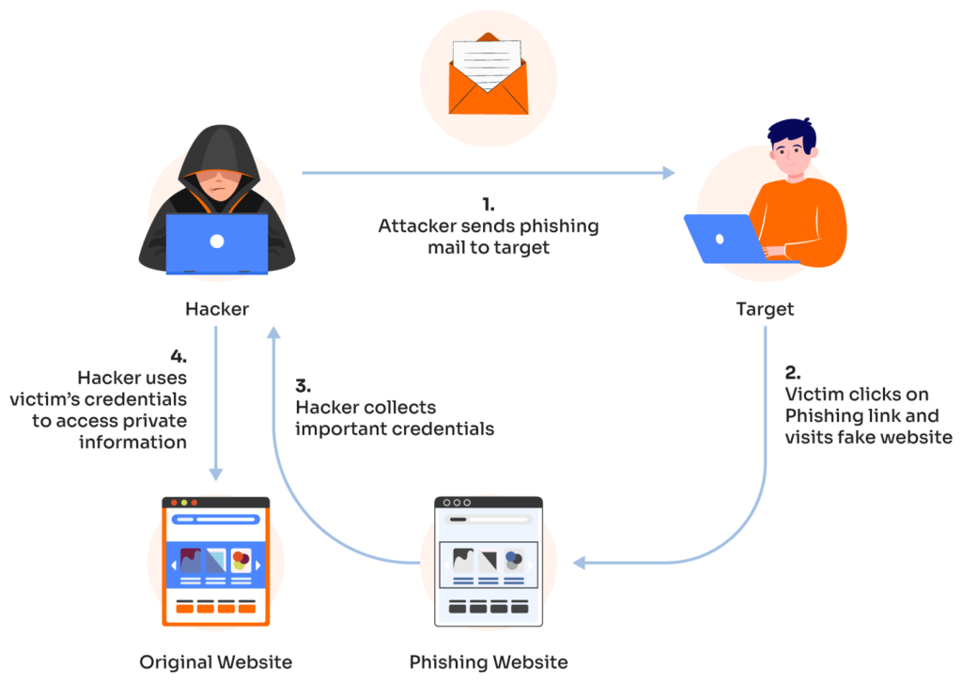
How does a phishing attack work?
Cycle of a Phishing Attack
1. Attacker sends phishing mail to target
Hacker
Target
4. Hacker uses victim’s credentials to access private information
3. Hacker collects
important credentials
2. Victim clicks on phishing link and visits fake website
Original Website
Phishing Website

Slide 5
Characteristics of phishing attack
INDIRECT GREETINGS
DOMAIN
TEXT WORDING
ATTACHEMENTS
PERSONAL INFORMATION
URGENCY
IRRESISTIBLE OFFERS

Slide 6
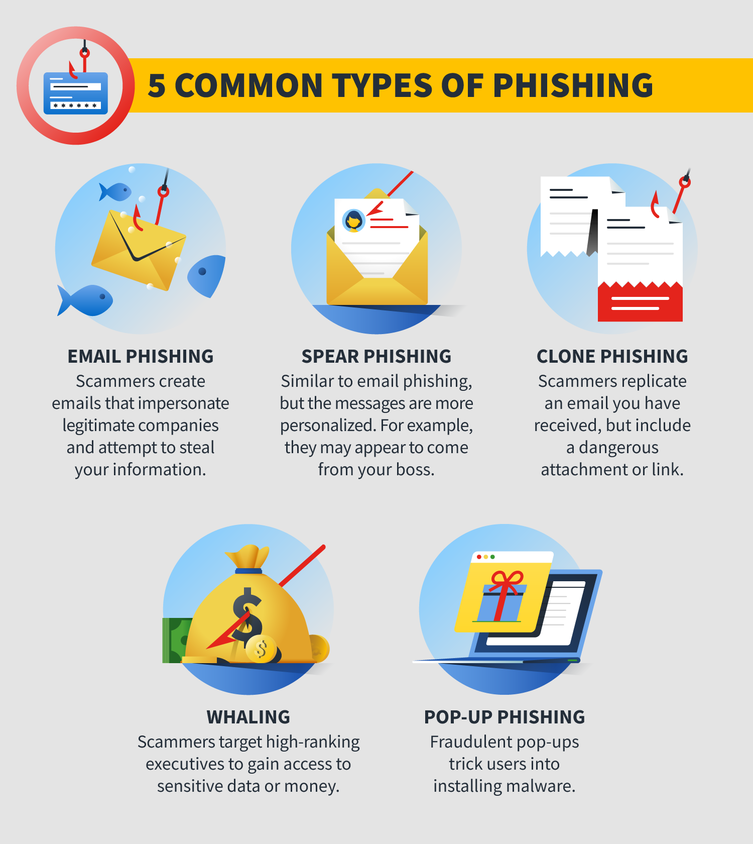
Types of phishing attacks
5 Common Types of Phishing Are :

Slide 7
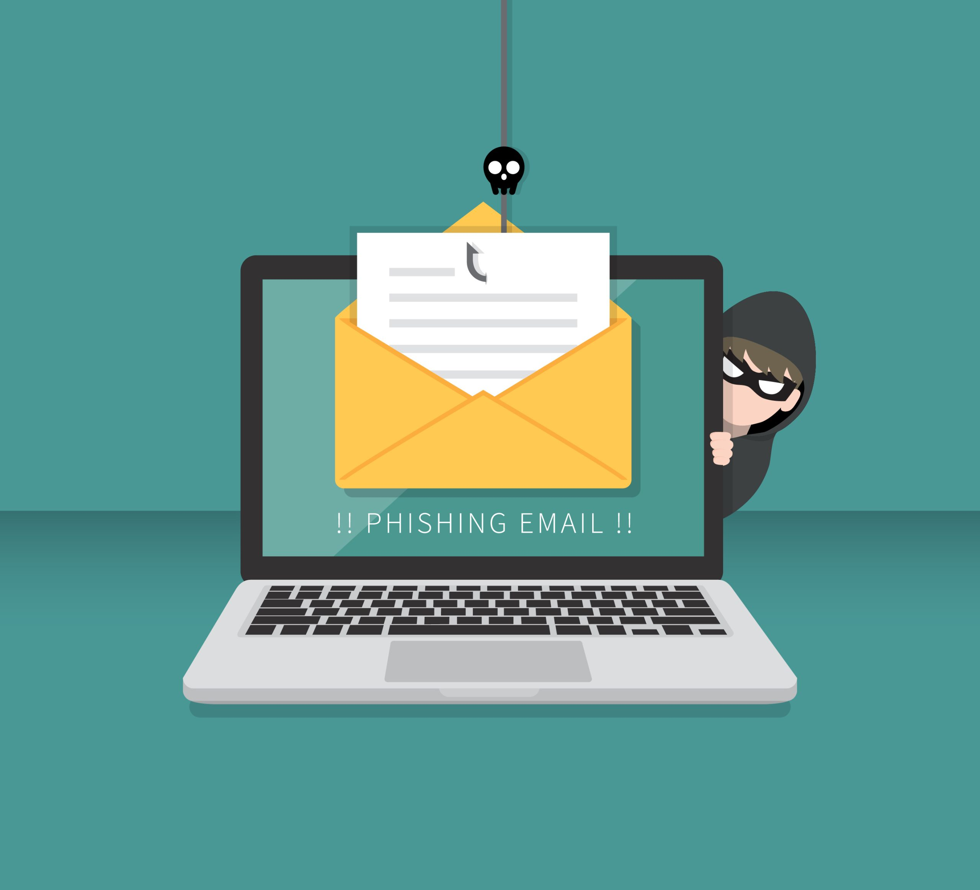
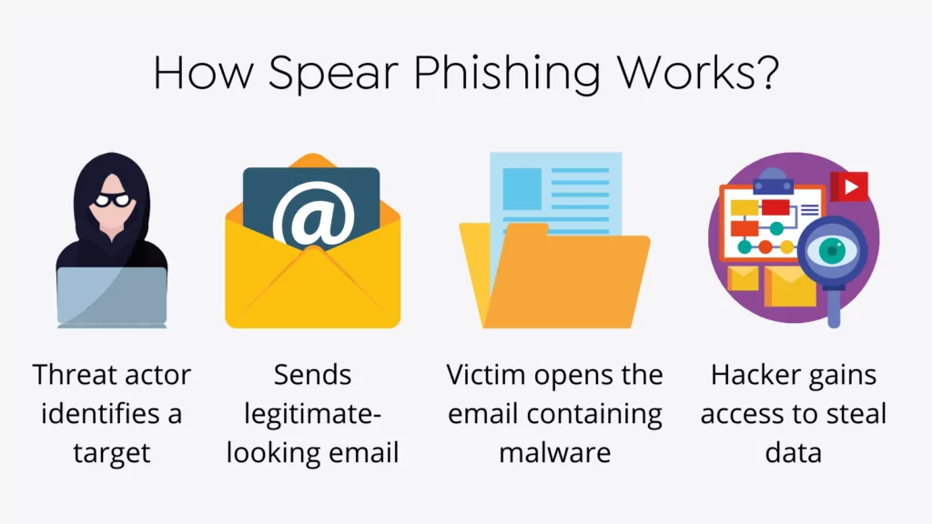
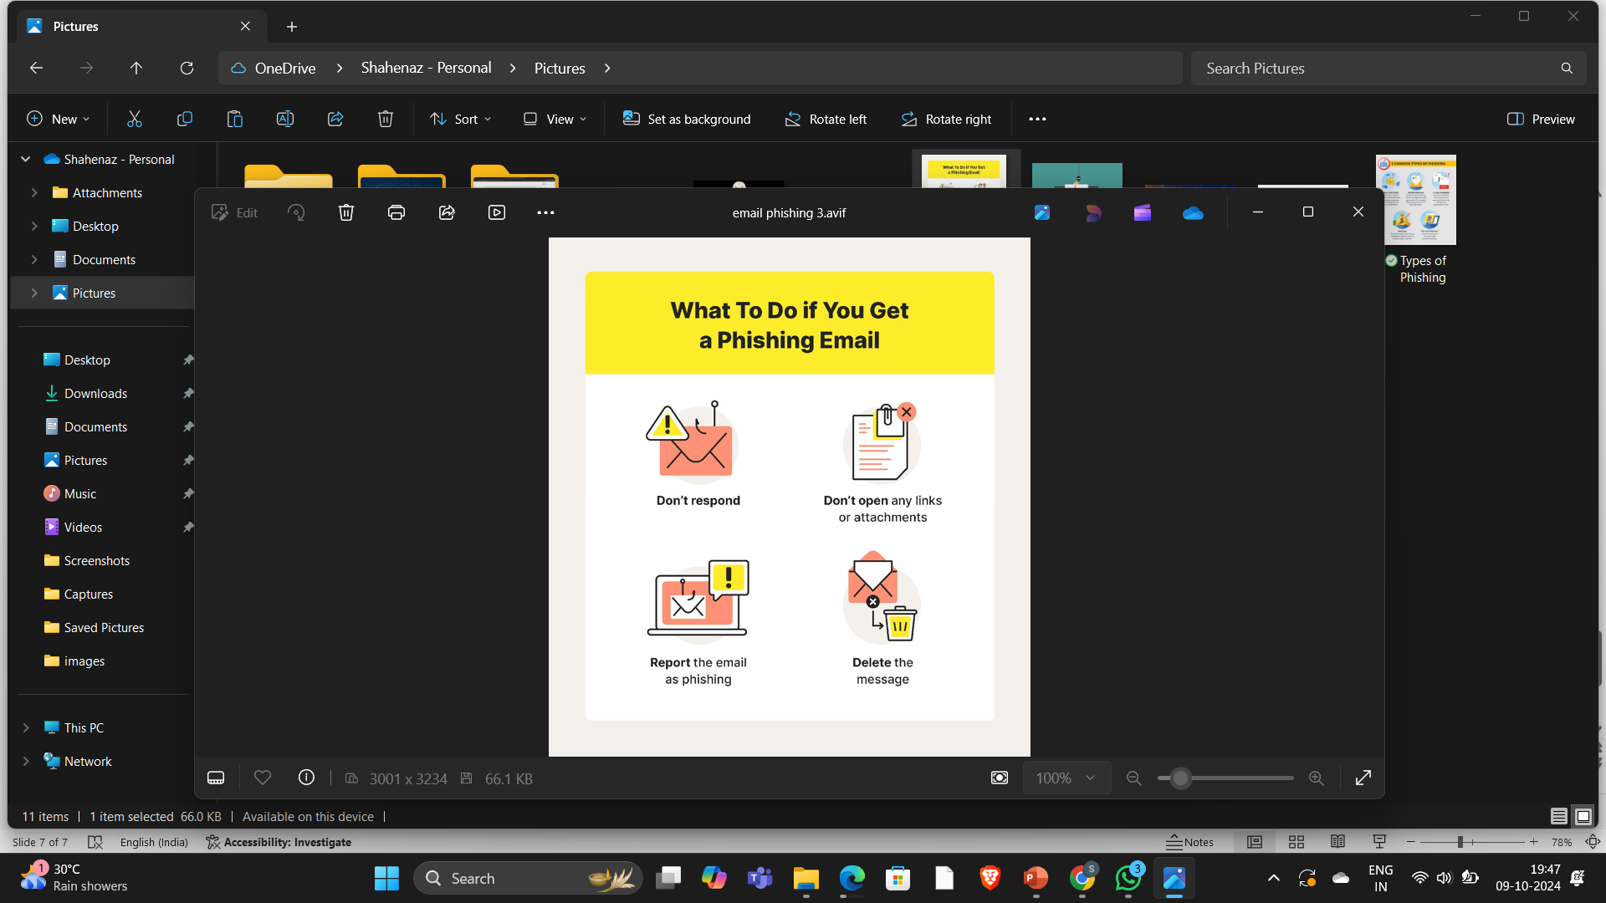
E-mail phishing
A phishing email is a fraudulent message crafted to trick recipients into revealing sensitive information like passwords or credit card numbers .
What to do if you get a phishing mail
How it works ?

Slide 8

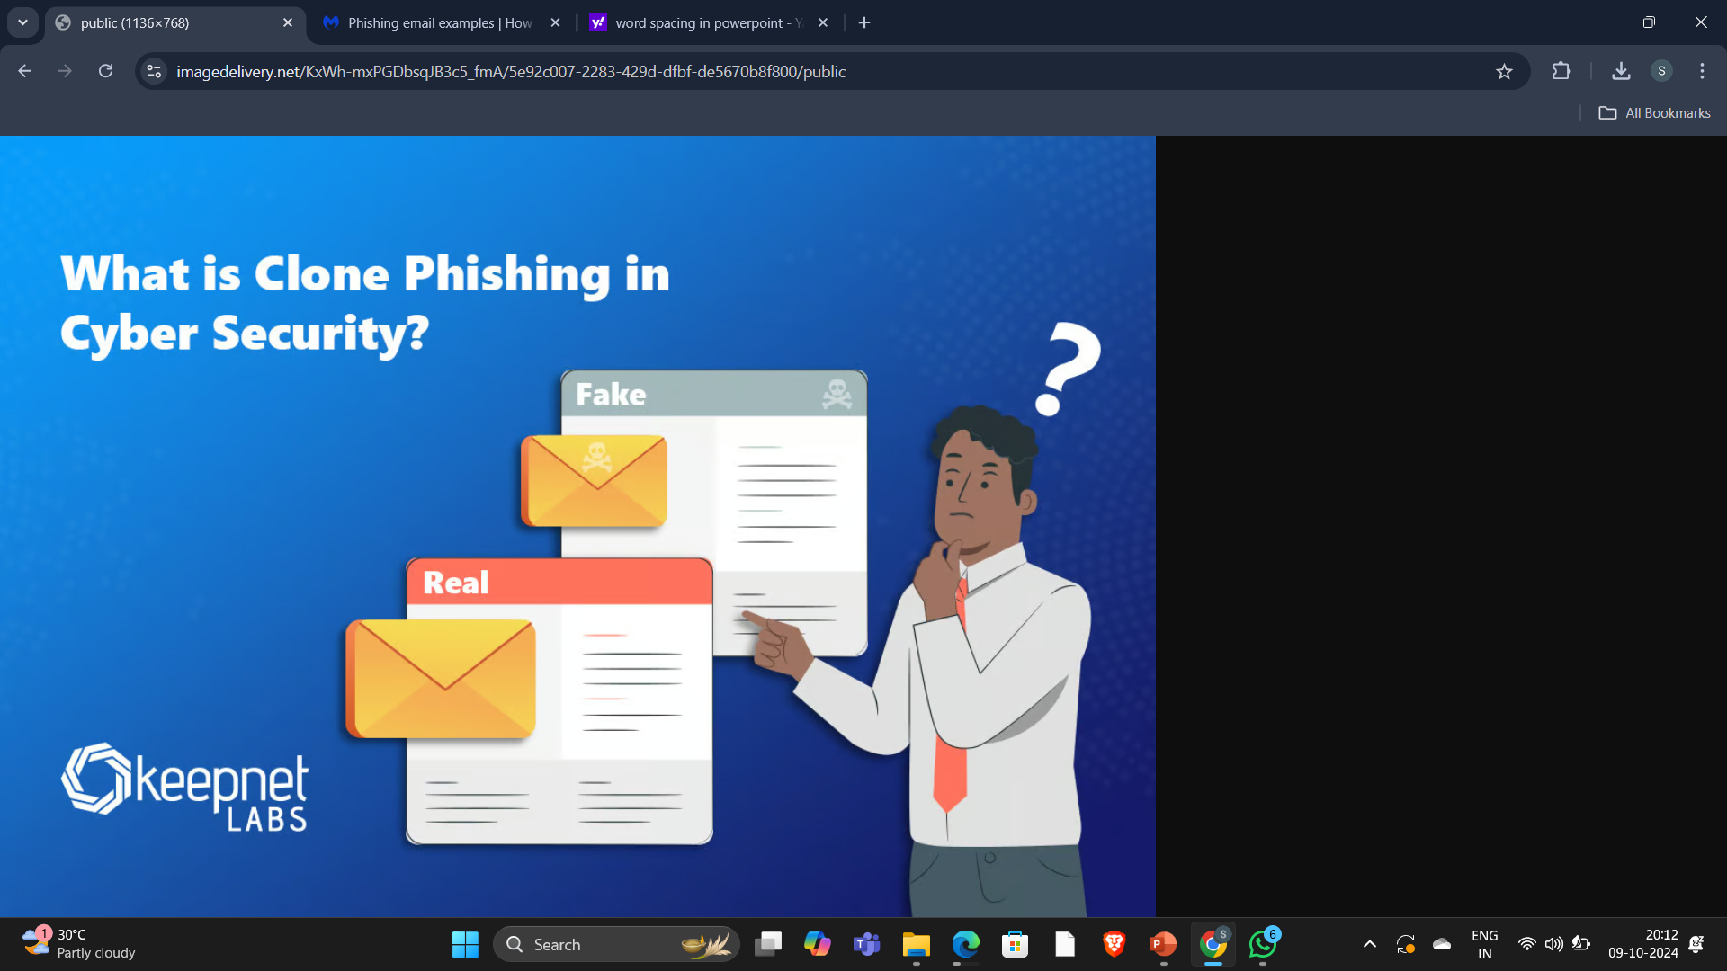
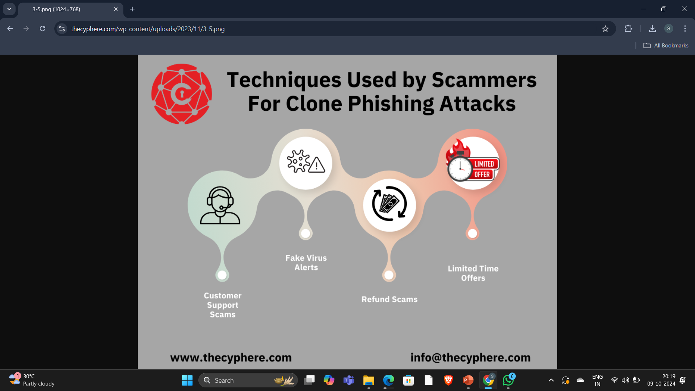
clone phishing
Clone phishing, similar to thread hijacking, is a newer type of email-based threat where attackers clone a real email message with attachments and resend it pretending to be the original sender. The attachments are replaced with malware but look like the original documents.
Techniques used by the scammers for clone phishing attacks

Slide 9
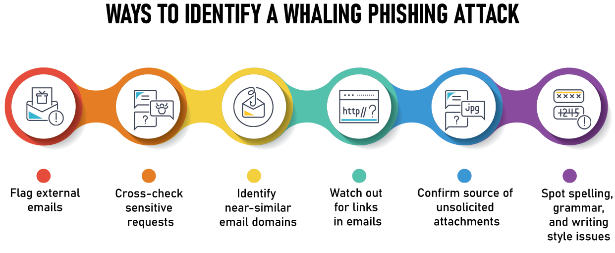
whaling
A Whaling Attack, also known as Whaling Phishing, is a strategic phishing attack, targeted towards high profile executives, that is disguised as a permitted email. An attacker can prod the target for information that helps them access sensitive areas of the network, passwords, or other user information.

Slide 10
Recognizing the phishing attacks
The first step to avoid being a victim of phishing is to recognize the signs. The following are the most common red flags that could indicate a phishing email:
An incorrect, obscure, unusually long, or otherwise suspicious-looking sender address.
Requests for personal or business information in any unsolicited message.
Requests that you change account details or perform other online activities.
Requests for personal information from seemingly official institutions. (Legitimate financial institutions and government agencies never do this.)
Any message that uses fear, threats, a sense of urgency, or an offer too good to be true as a motivator.
Any message with a subject containing words like “Action Required!,” “Urgent!”
Any message that contains an odd or unexpected subject matter, incorrect grammar, punctuation errors, misspellings, etc.
Messages from trusted parties (friends, co-workers, company executives) that request personal information (address, phone number, personal email alias) or that seem “off” in subject matter, tone, grammar and structure, embedded links, time of day sent, etc.
Embedded URLs that contain misspelled names or substitute characters (for example, b@nkof1ndiana.com (where the numeral 1 is meant to look like the letter I) or arnazon.com, where the space between the r and the n is condensed to appear like the letter m.
Shortened URLs, which often direct users to phishing websites.
Messages sent to an unusual or unlikely group of recipients.
Messages with an awkwardly worded or non-specific greeting (Hello Customer, Hi Dear) or use a full name (Hi John Doe).
Watch for similar warning signs in other delivery platforms such as text messages, social networking sites, and Internet forums.

Slide 11
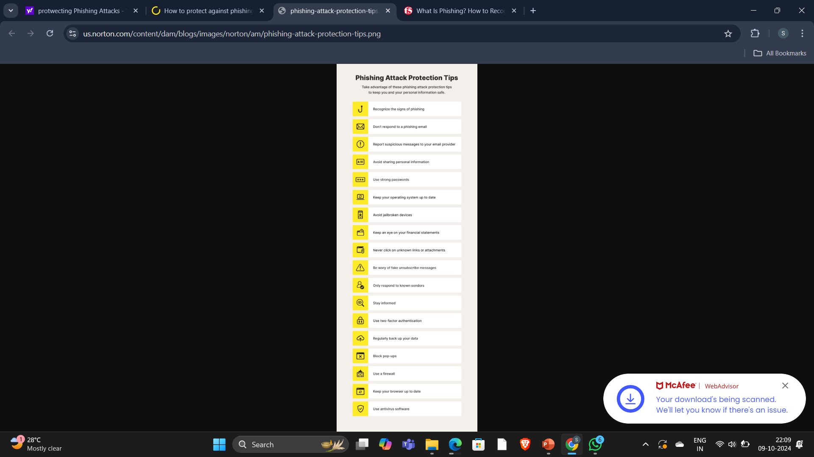
protecting the phishing attacks

Slide 12
avoiding the phishing attacks
As much as we all might like to live in a “trust but verify” world, none of can afford to do that anymore. The digitally interconnected world we live in today is rife with online fraud because it offers cybercriminals limitless opportunities for impersonation and anonymity. Whether we like it or not, we all must adapt our attitudes and behavior to a “never trust, always verify” approach if we want to avoid being victimized.
Recommendations for individuals:
Be cautious about all unsolicited email and text messages.
Hover over embedded links (without clicking) to reveal the actual URL and compare it the link that’s shown.
Never click embedded links, even if you think they’re trustworthy. Instead, use your browser to search for the correct URL.
Never open attachments of any kind in unsolicited email. In email from known senders, separately verify attachments before opening them.
Use anti-virus and anti-malware on your personal devices and keep them updated.
Use multifactor authentication on every account that offers it to prevent cybercriminals from accessing your accounts.
Use a password manager to avoid credential stuffing attacks .
Enterprises can help to mitigate phishing attacks by implementing the following security controls .
Conduct regular and continually updated user training; this your most powerful weapon and should not be considered optional. Train users in attackers’ latest phishing tactics and how to recognize and respond to phishing across all delivery mechanisms (email, text, IM, social networking, and malvertising).
Deploy multifactor authentication (MFA) to prevent credentials that have been compromised in phishing attacks from being used by attackers to access other apps and resources.
Use anti-virus and anti-malware solutions to automatically quarantine suspicious files and prevent installation of malware.
Use a web filtering solution to block outbound traffic to phishing sites when employees inadvertently click malicious links.
Make it easy for employees to report suspected phishing emails.
Inspect SSL/TLS-encrypted traffic to detect encrypted malware.
Inspect URLs within email messages to detect links to known malicious websites.

Slide 13
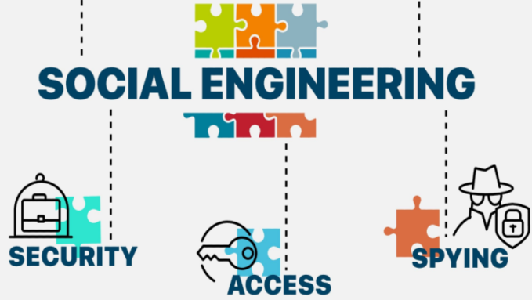
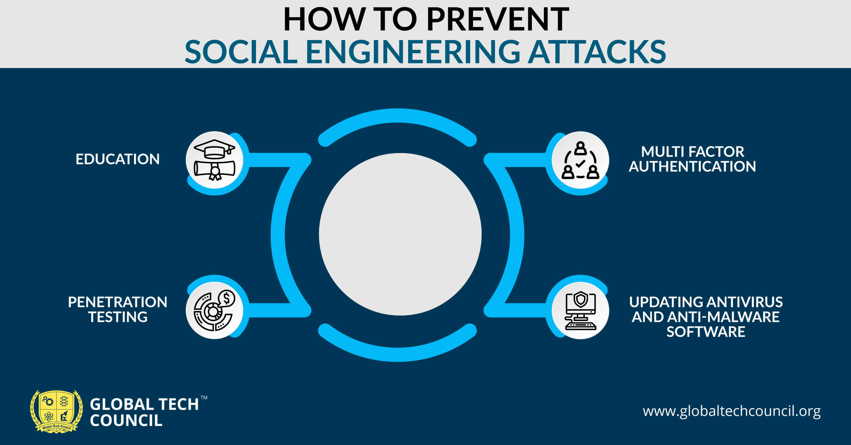
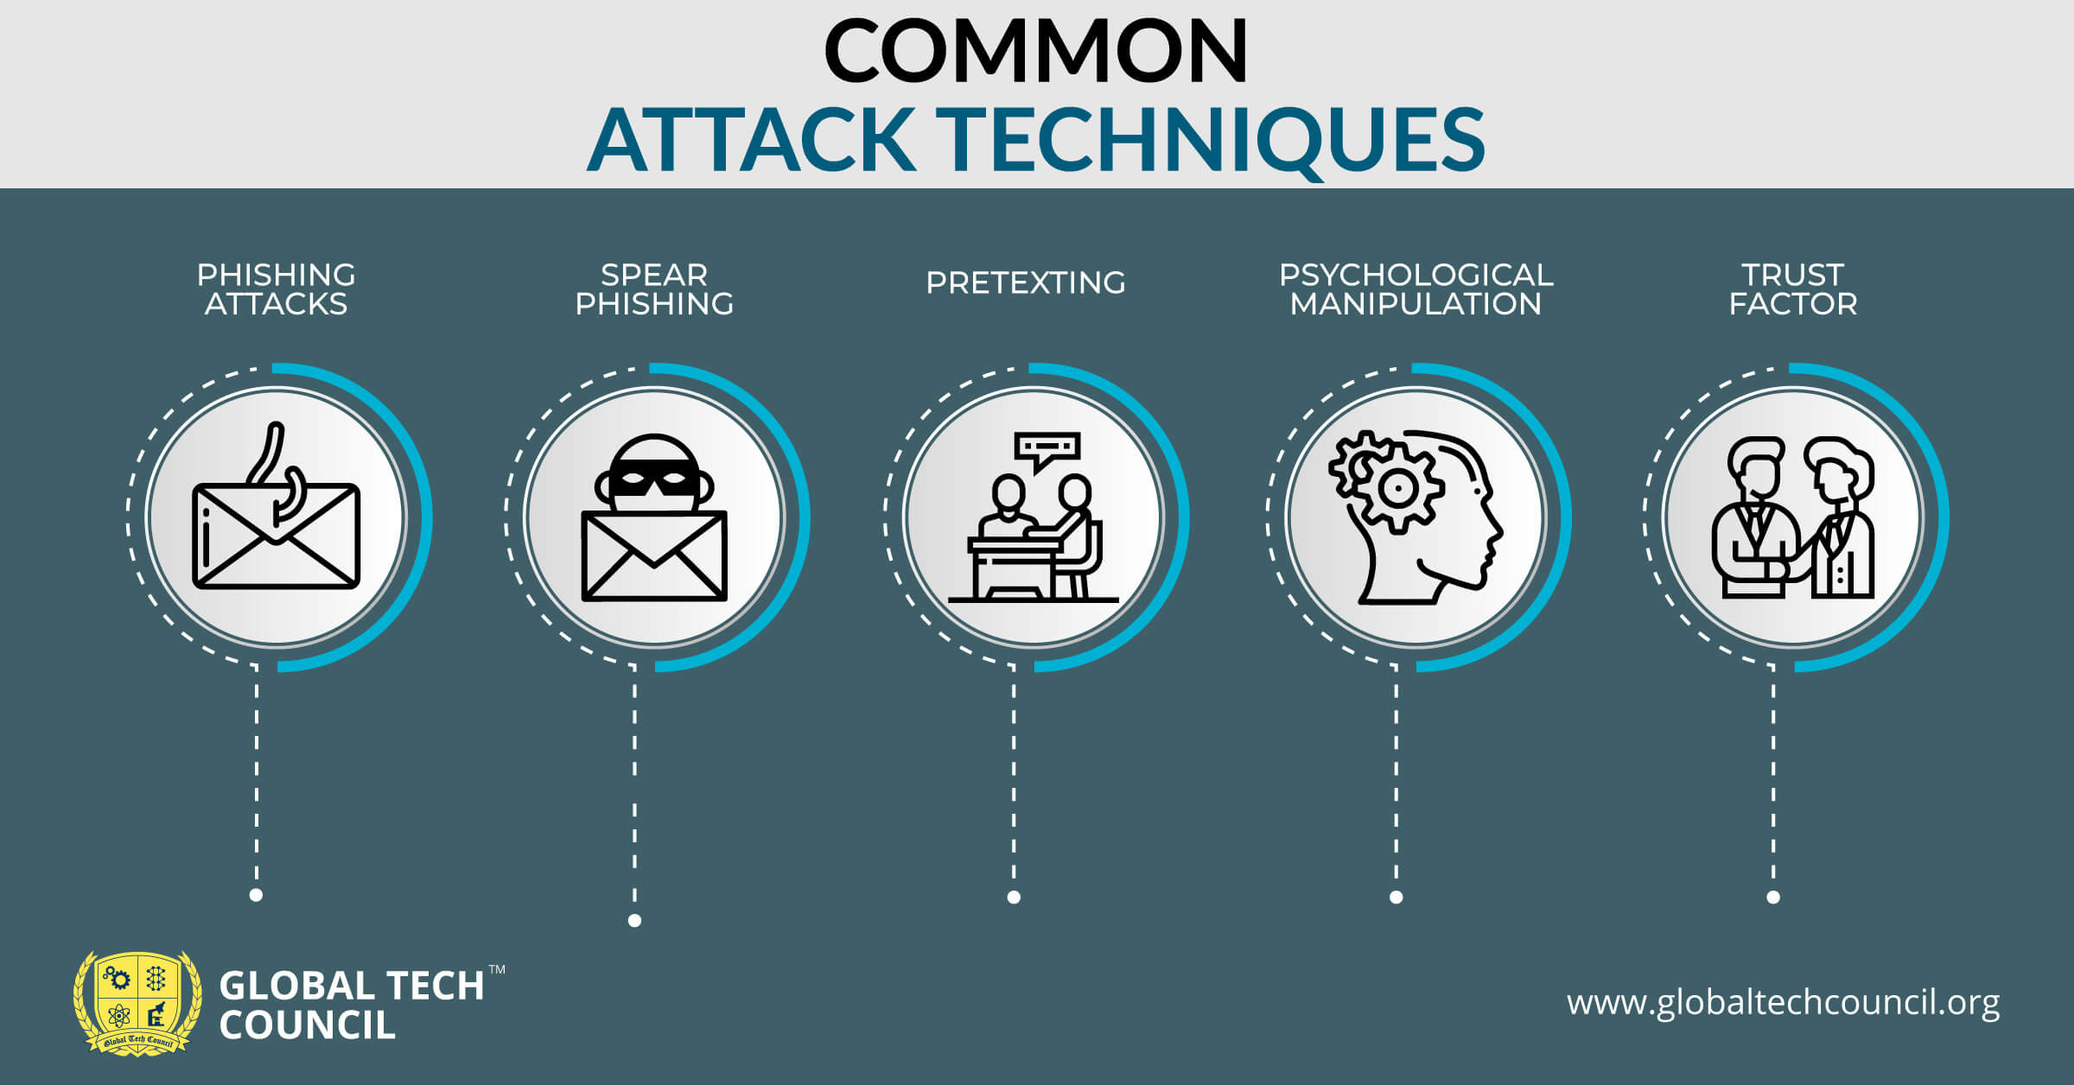
Social engineering tactics /attacks
Social engineering is an attack vector that relies heavily on human interaction and often involves manipulating people into breaking normal security procedures and best practices to gain unauthorized access to systems, networks or physical locations or for financial gain.
HOW IT IS DONE ?

Slide 14
